Slide 1

KLS Summer School Spatial transcriptomics 101
Joane P. Bernardo & Florina Trans
16th September 2025

Slide 2
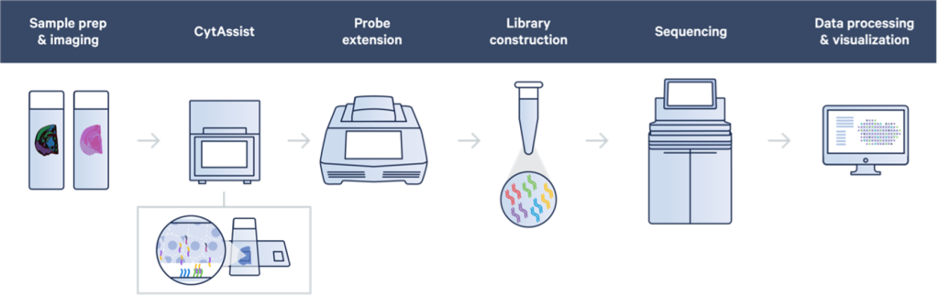
Hands-on workshop
Florian Tran
Joana P. Bernardes

Slide 3
Schedule day 2: 16th September
Location: IKMB: Institute of Clinical Molecular Biology- CAU University
Room: 4th floor Lecture Hall
Theoretical introduction: 10:45-12:00
lunch break: 12:00-13:00
Hands on workshop: 13:00-17:00

Slide 4



Hands-on Workshop
Get into groups of 5: sit together and work together.
In groups of 5 will be taken downstairs to the lab.
The rest of the time bioinformatics
workshop on spatial transcriptomics.

Slide 5
Theoretical introduction
Concepts of spatial RNA-seq technology
Workflow of spatial transcriptomics processing
Spatial insights in science
Limitations of the technology

Slide 6
Spatial technologies

Slide 7
Spatial workflow

Slide 8
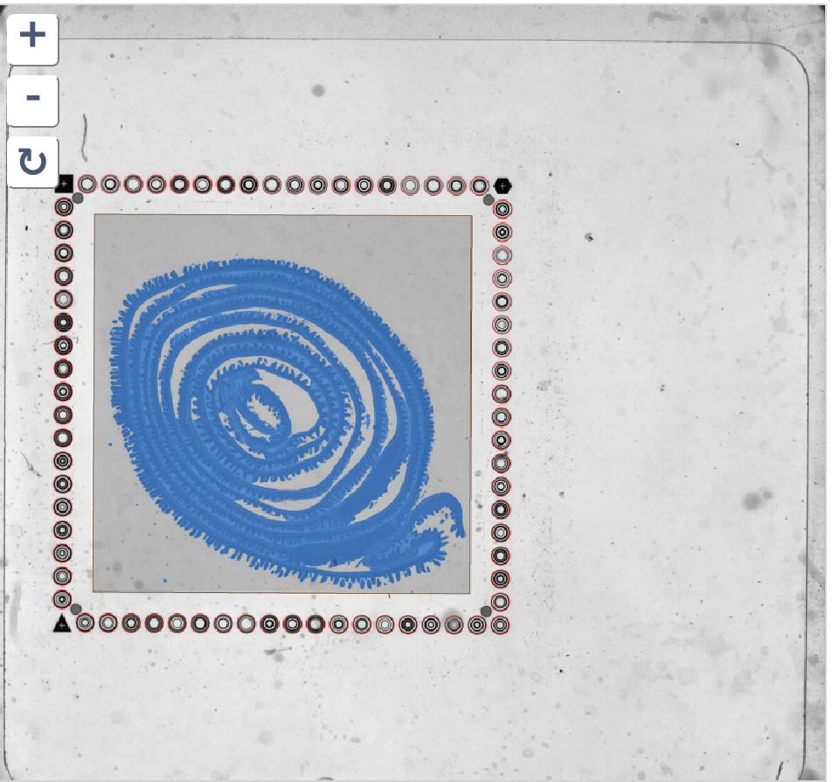
Space ranger workflow (image)
Fiducial alignment
Tissue detection
Brightfield image
Map tissue in capture area
Tilt correction
Image registration
scale, translation, rotation
Cell segmentation
cell and nuclei

Slide 9
Space ranger workflow (reads)
.fastq
QC reads
Map reads
Count matrix
QC cells
filter samples
Integrated object
QC clusters
cluster annotation

Slide 10
From reads to count matrix
QC reads
Map reads
.fastq
space ranger
sequenced output
demultiplexed data
.fastq

Slide 11
From reads to count matrix
QC reads
Map reads
.fastq
space ranger
sequenced output
demultiplexed data
.fastq
identify correct cell barcodes
Trim, align reads to genome annotation (STAR)
.bam
tag reads with gene
correct UMI sequences
count matrix
binns
features

Slide 12
From reads to count matrix
QC reads
Map reads
.fastq
space ranger
sequenced output
demultiplexed data
.fastq
identify correct cell barcodes
Trim, align reads to genome annotation (STAR)
.bam
tag reads with gene
correct UMI sequences
 | binn 1 | binn 2 | binn 3 | ... | binn 15K
Gene 1 | 3 | 3 | 1 |  | 2
Gene 2 | 0 | 2 | 0 |  | 1
Gene 3 | 1 | 0 | 3 |  | 5
...
Gene K | 14 | 7 | 1 |  | 0
...
Gene 25K | 0 | 13 | 1 |  | 0
count matrix
binns
features
Lots of zeros due to dropout or no expression
Variable total counts across cells – cell specific bias
Variable counts per gene – part biological, part technical

Slide 13
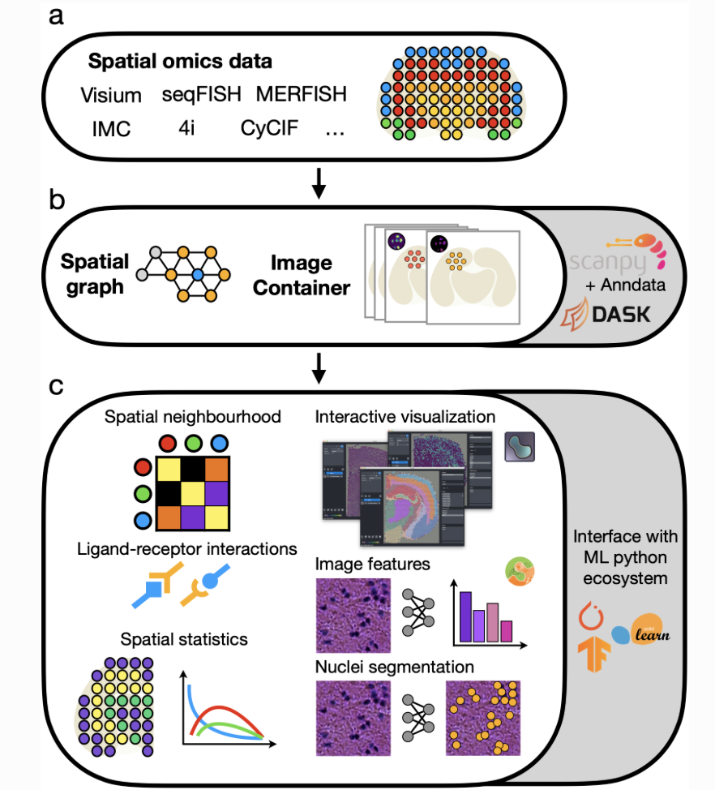
From matrix to objects
Create object
R packages
Seurat V5 > S4 seurat object
Banksy V1 > SingleCellExperiment
Python packages
Squidpy V1.7.0 > Anndata
SpaGCN 3.0.0 > h5ad

Slide 14
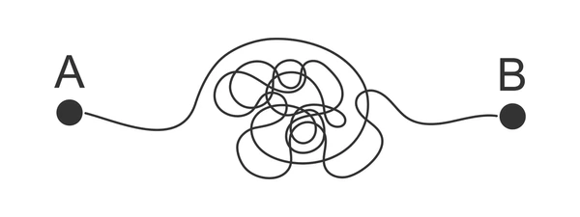
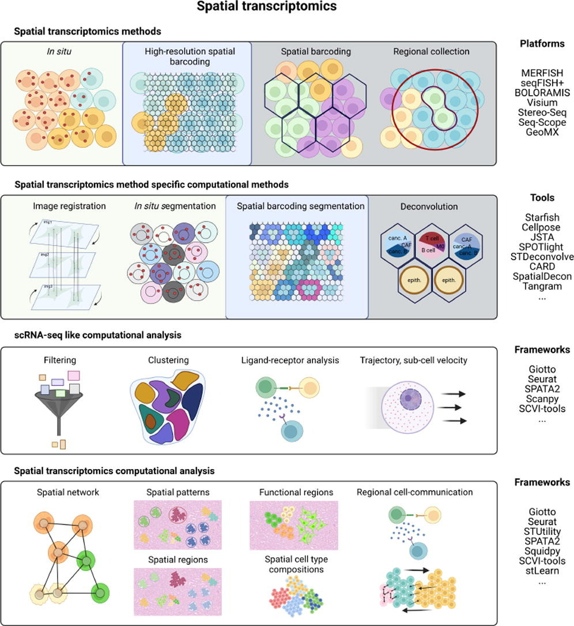
Spatial transcriptomics analysis
Our workshop
Annotated objects
Matrix
Integrated objects

Slide 15
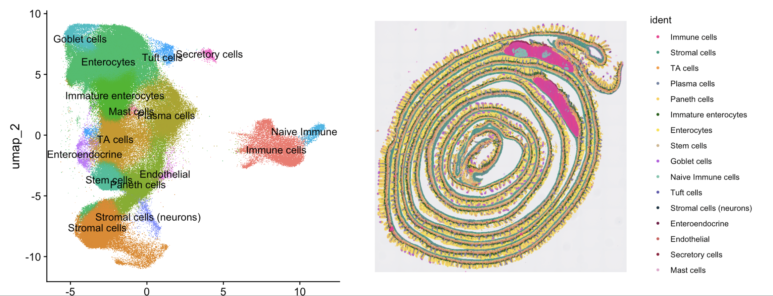
Multiple cell annotated object(s)

Slide 16

Biologic insights
Experimental design and null hypothesis:
Treatment vs. No treatment
Disease vs. Healthy
KO vs. Wils-type
Therapy response
Longitudinal follow-up

Slide 17
Spatial transcriptomics analysis
cell proportion
analysis
scCODA
Differential gene expression
MAST
Coexpression analysis
ANOVA
Mixed linear models
hdWGCNA
Cell-cell comunication
Cellchat
Wilcoxon
Single-cell-like analysis
e.g. treated vs. non-treated or throughout timepoints

Slide 18
Cell proportion analysis
cell proportion
analysis
scCODA
ANOVA
Mixed linear models
Identifies significant changes in cell proportions
based on treatment or other parameters.
Disadvantages:

Slide 19
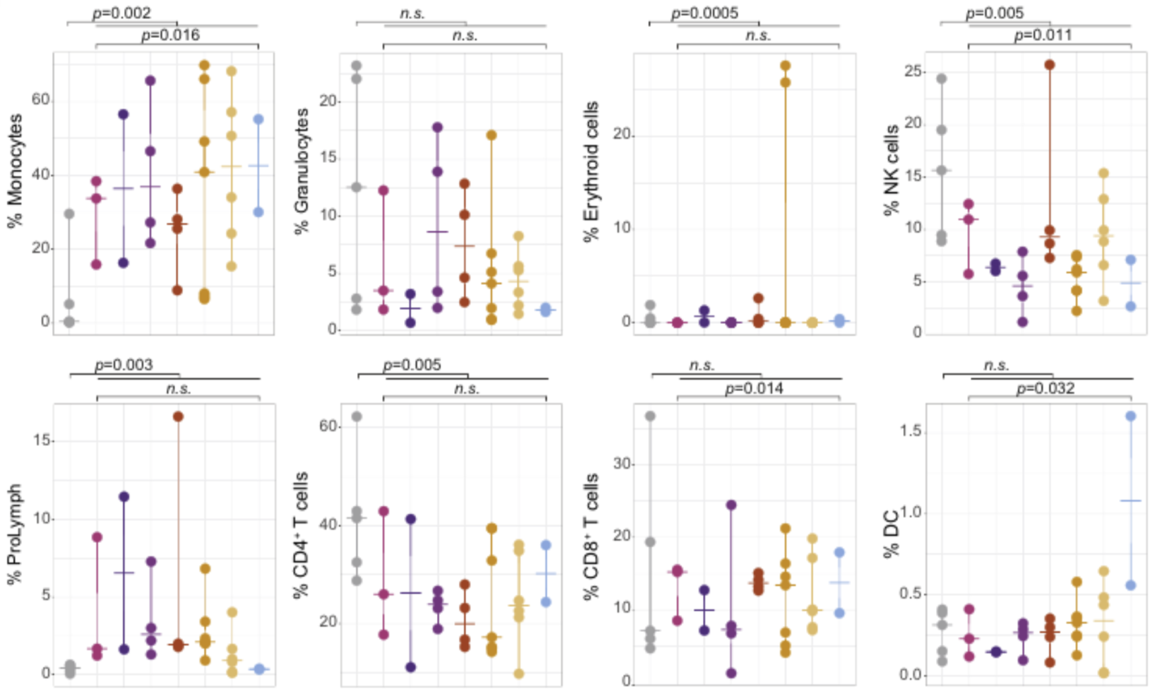
Cell proportion change through time: Mixed linear model
Cell proportion change between healthy and covid19: ANOVA
Bernardes JP, Mishra N Tran F et al. Immunity 2020

Slide 20
Differential expression analysis
Differential gene expression
GO enrichment
KEEG enrichment
Identifies expression changes between treatments,
for individual genes within a cell type. Differential expression can be based on:
Signature genes: compare one against all other groups/clusters.
Pairwise comparisons: compare one group (e.g. treatment) to another group.
Disadvantages:

Slide 21
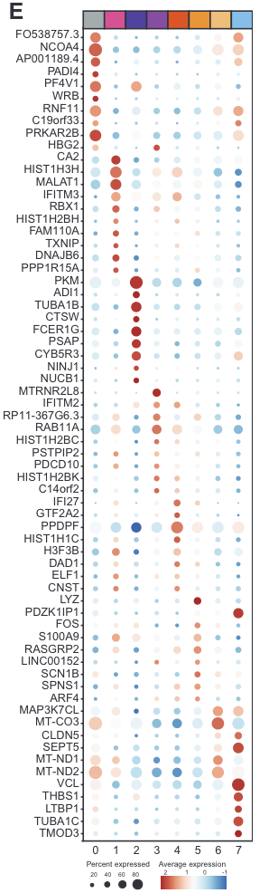
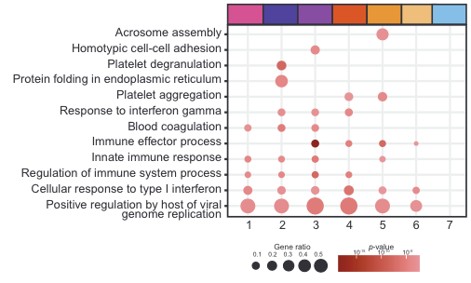
Differentially expressed genes can also be used to inform GO terms enriched throughout timepoints
Bernardes JP, Mishra N Tran F et al. Immunity 2020

Slide 22
Coexpression analysis
Coexpression analysis
GO enrichment
KEEG enrichment
Specially useful for longitudinal studies. Groups
genes into modules that change similarly throughout time for a particular cell-type.
Based on differentially expressed genes
Relate modules with clinical parameters
Disadvantages:

Slide 23
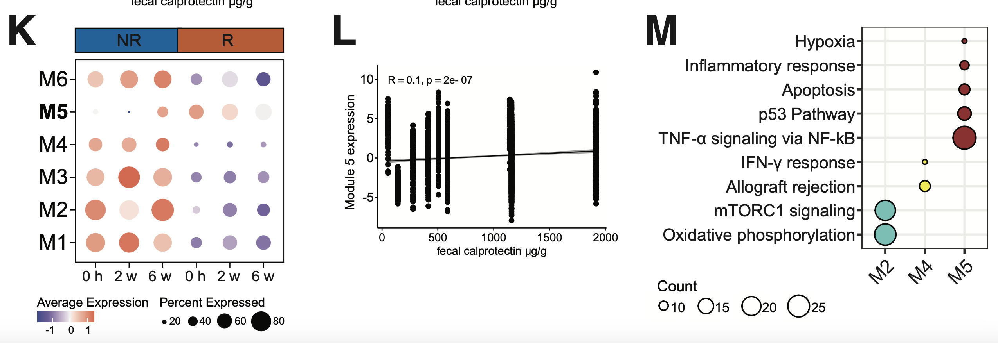
Coexpression modules in cell-types of interest
Bernardes JP, in prep

Slide 24
Cell-cell communication
Cell-cell communication
Cellchat
inference of spatially proximal cell-cell communication between interacting cell groups from spatially resolved transcriptomics
Disadvantages:

Slide 25
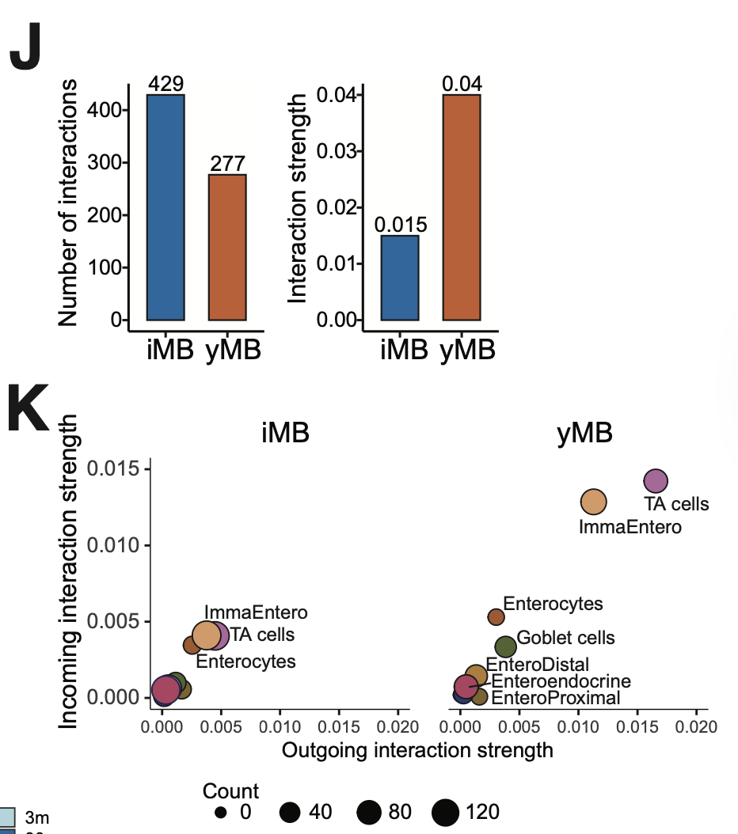
Cell-cell communication using cell-cell contact only
Sommer F, Bernardes JP, Microbiome 2025

Slide 26
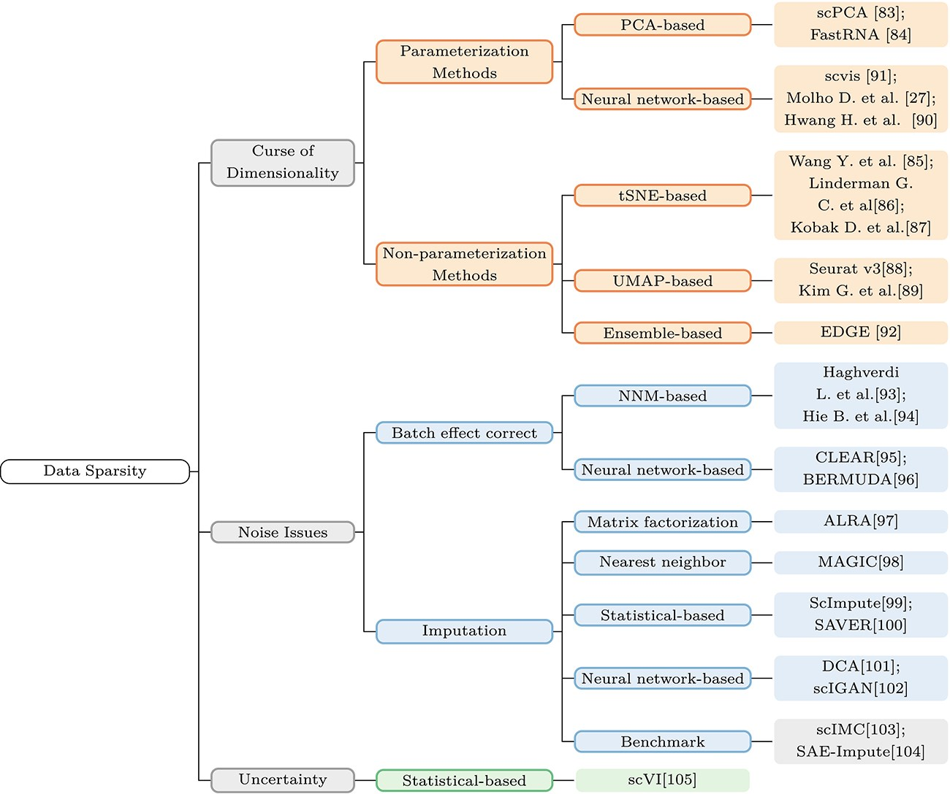
Limitations of the technology
Brief Bioinform, Volume 26, Issue 2, March 2025, bbaf136, https://doi.org/10.1093/bib/bbaf136

Slide 27
Limitations of the technology
Price
Tissue collection
Time
Computational limitations

Slide 28
Workshop: spatial transcriptomics 101
Theory: Introduction to spatial transcriptomics
- Concepts of spatial RNA-seq technology
- Workflow of spatial transcriptomics processing
- Limitations of the technology
Workshop: Practical spatial transcriptome analysis 101
- Workflow of spatial transcriptomics analysis
Mouse swiss roll as example

Slide 29
Step 1: Setting up your R environment
Open R Markdown
Load packages
Set folder to work
Set session
Download data set from 10x genomics:
https://www.10xgenomics.com/datasets/visium-hd-cytassist-gene-expression-libraries-of-mouse-intestine

Slide 30
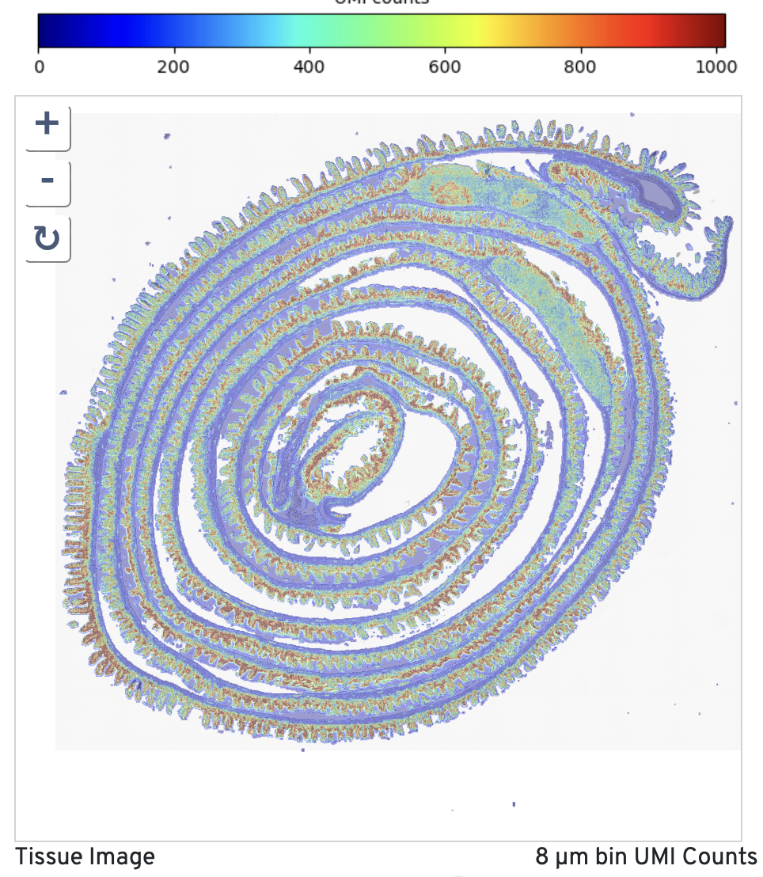
1. Loading the dataset
Open Visium_HD_Mouse_Small_Intestine_web_summary.html
Intestinal epithelium
What is a UMI, read, gene, bin?

Slide 31
1. Loading the dataset
Get familiar with the Seurat object:
Bins: represent the spatial units
- Genes: genes being measured
- Assay data: can contain the gene expression data, chromatin accessibility, surface proteins, etc.
- Metadata for bins: information about each bin (e.g., sample type, condition)
- Metadata for genes: includes gene IDs, names, types, and descriptions

Slide 32
1. Loading the dataset
Get familiar with the Seurat object:
- Dimensionality reductions: Methods like PCA, UMAP, and tSNE that are used to reduce the complexity of the data
- Neighbors and graphs: Information about the relatedness between bins
- Images: Spatial coordinates and image data for visualizing the tissue

Slide 33
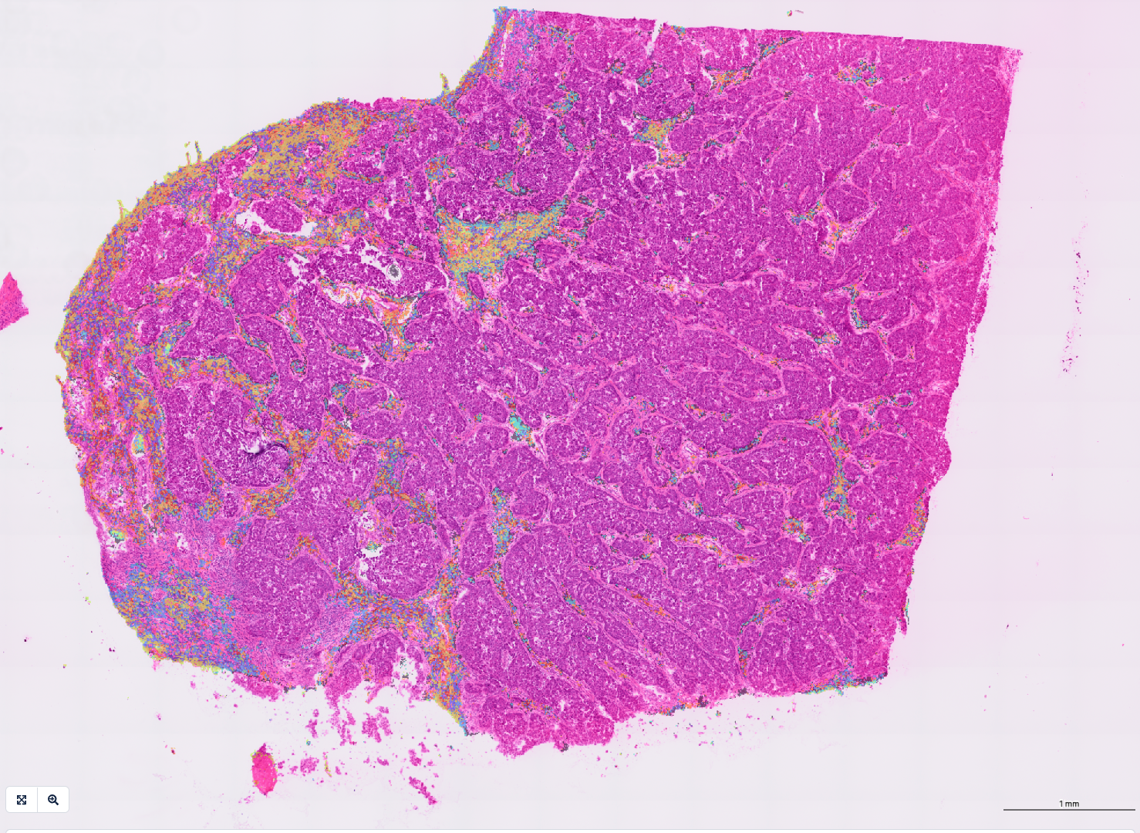
2. Quality control
Not all bins/genes are equally informative:
Low-quality bins:
Cell damage
Empty regions
Overlap of cut(s)

Slide 34
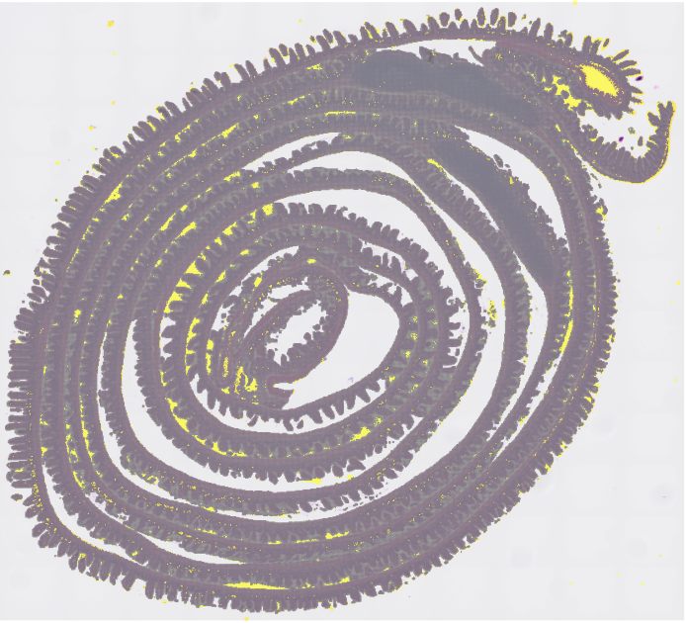
2. Quality control
Not all bins/genes are equally informative:
Low-quality bins:
Cell damage
Empty regions
Overlap of cut(s)
QC of bins
Number of counts/UMIs
Number of genes
Mitochondrial gene content

Slide 35
2. Quality control
Not all bins/genes are equally informative:
Low-quality genes:
Low expressed genes can add noise: Many lowly expressed genes fluctuate randomly due to stochastic transcription.
QC of genes
Genes expressed in lower than 10-30 bins (depends on the set-up)

Slide 36
3. Processing pipeline
1. Normalization of raw counts
2. Identification of highly variable genes (HVGs)
3. Centering and scaling of those HVGs
(4. Optional sketching of the dataset for speed (HVGs))
5. Dimensionality reduction (PCA) based on the HVGs

Slide 37
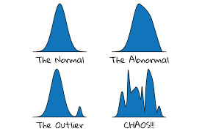
3. Processing pipeline
1. Normalization of raw counts
Why? To make counts comparable across bins.
NormalizeData():
- Per bin, the count for each gene is divided by the total count for that bin, and then multiplied by 10,000.
- These "counts per 10,000" are then log-transformed using the natural logarithm.

Slide 38
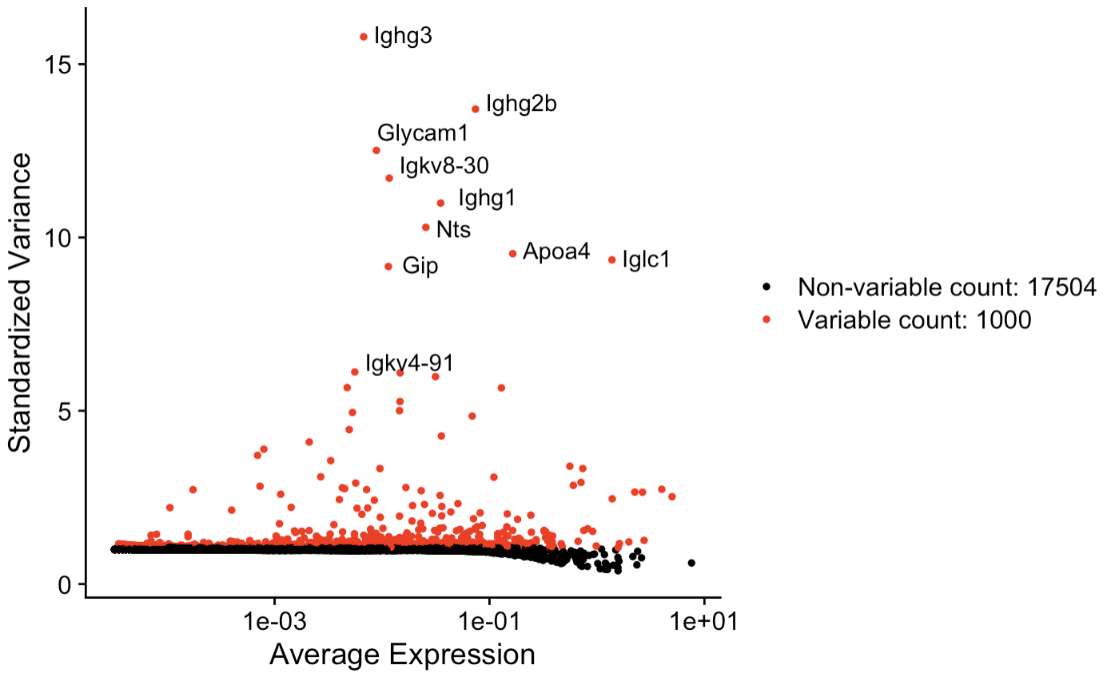
3. Processing pipeline
2. Identification of highly variable genes (HVGs)
Why? Focus on the informative genes are more
likely to distinguish biological states.
VariableFeatures():
- computes mean expression and variance for each gene.
- It models the expected variance given the mean (since highly expressed genes naturally have higher variance).
- Based on standardized variance (dispersion), it identifies the top genes as highly variable features (e.g. top 1,000).

Slide 39
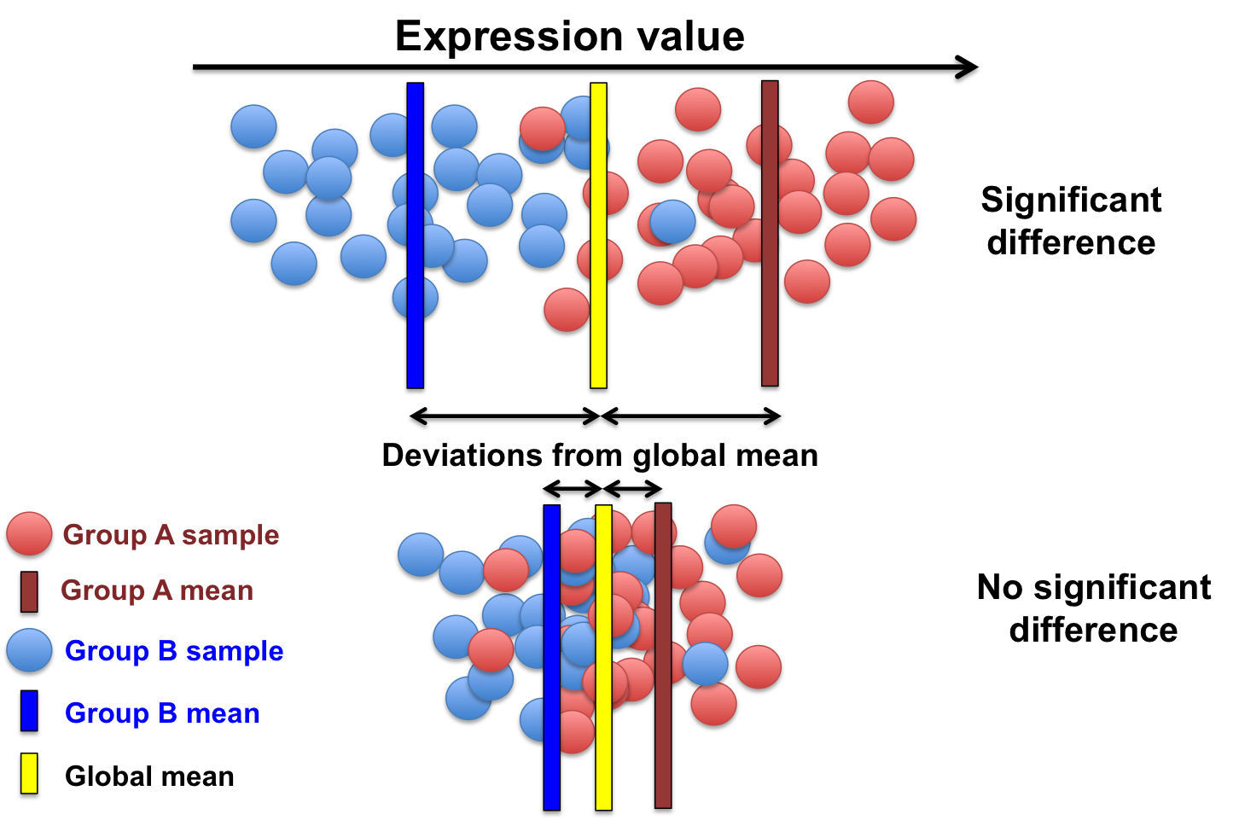
3. Processing pipeline
3. Centering and scaling of those HVGs
Why? To put all genes on the same scale
and comparable
ScaleData():
- For each gene, it adjusts the values so the average expression across all cells is 0 and the spread of the values is uniform.
- All genes are on the same scale, no matter how strongly or weakly they are expressed.

Slide 40
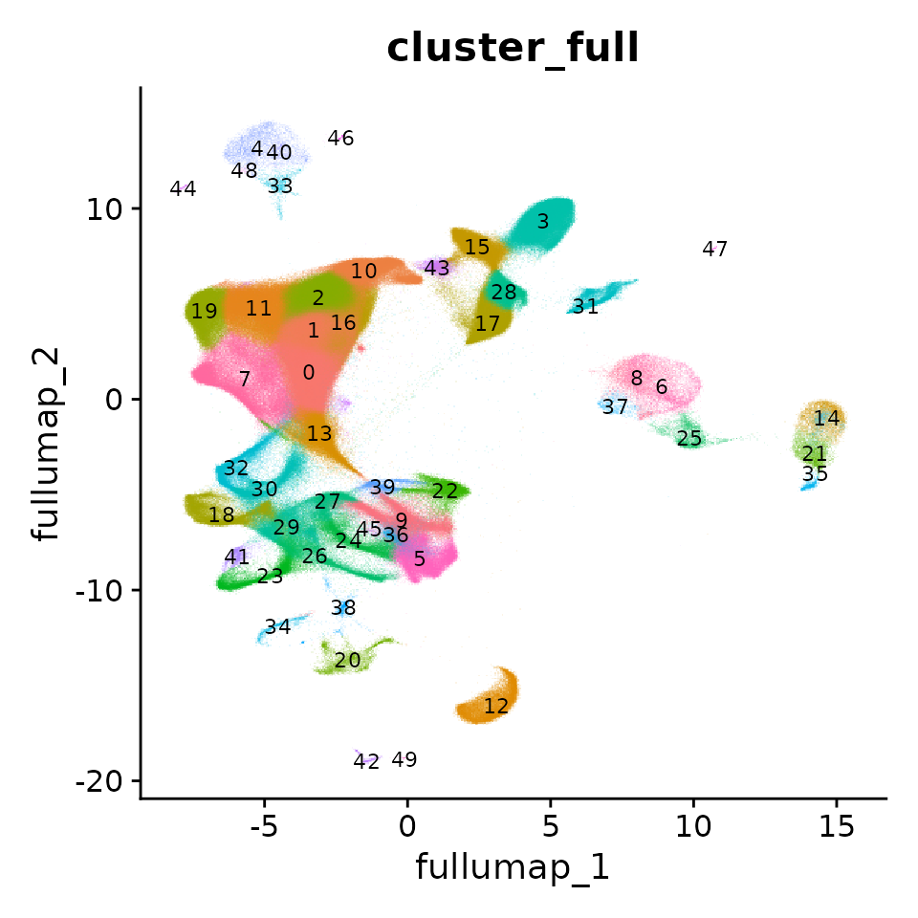
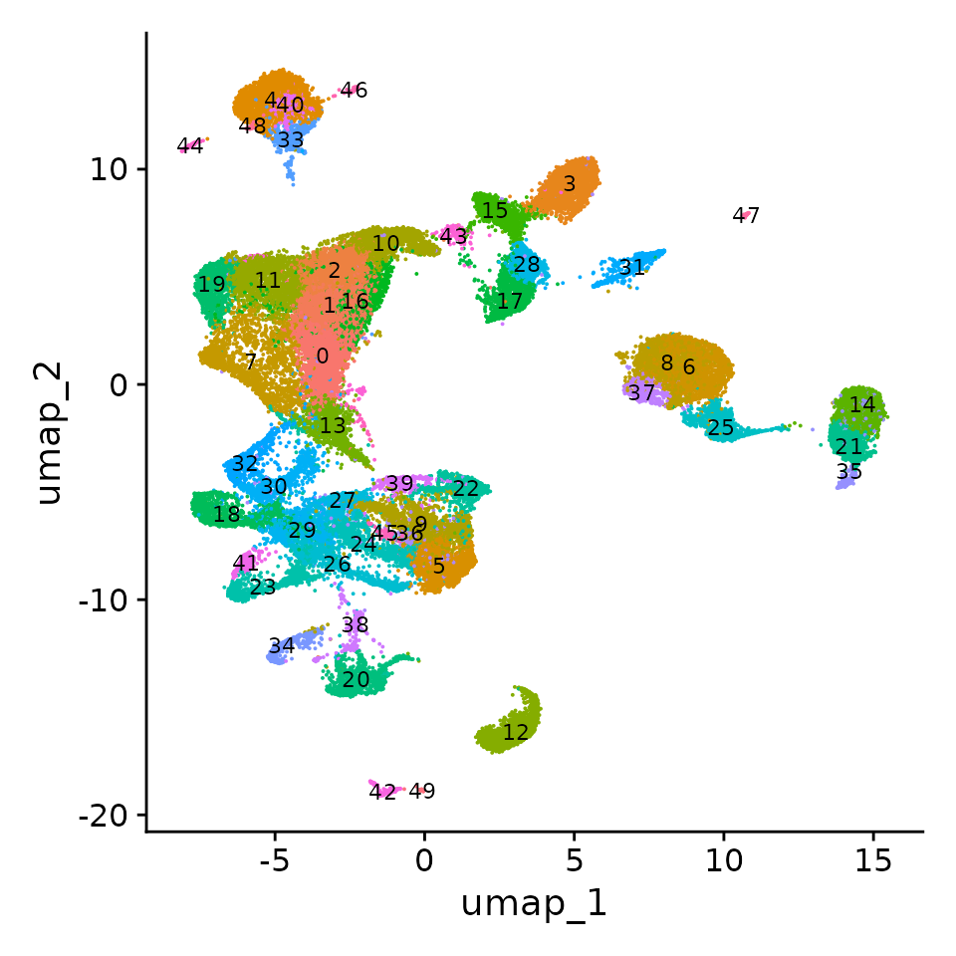
3. Processing pipeline
(4. Optional sketching of the dataset for
speed (HVGs))
Why? Large datasets can slow down clustering and UMAP
SketchData():
- Instead of random sampling, Seurat uses a leverage score to keep influential or rare bins.
- Creates a reduced representation while preserving rare cell populations.

Slide 41
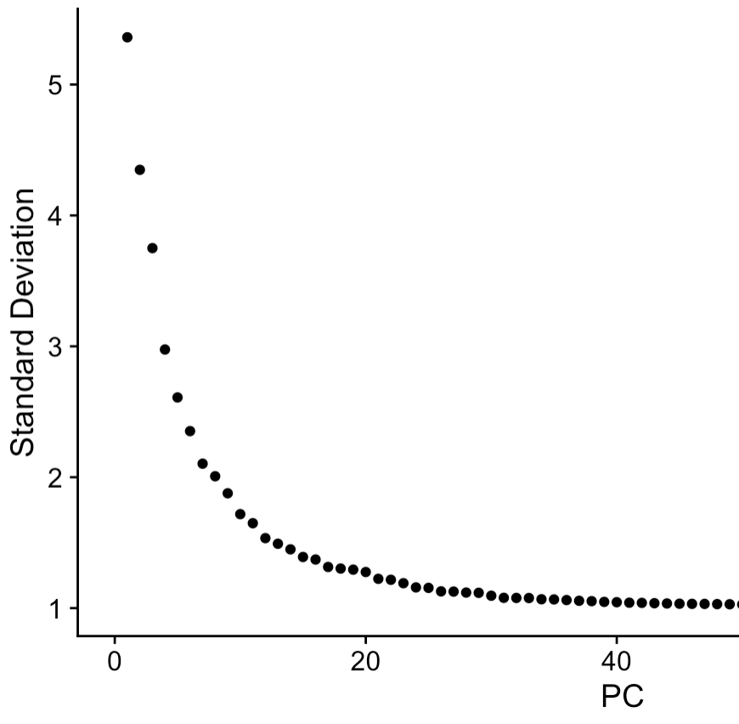
3. Processing pipeline
Dimensionality reduction (PCA) based on HVGs
Why? Reduce the complexity/dimensionality of the
dataset without losing the dataset variance.
RunPCA():
- It performs Principal Component Analysis (PCA) on the gene expression matrix.
- Instead of looking at thousands of genes directly, PCA finds new "summary axes" (principal components, PCs) that capture the main patterns of variation in the data.

Slide 42
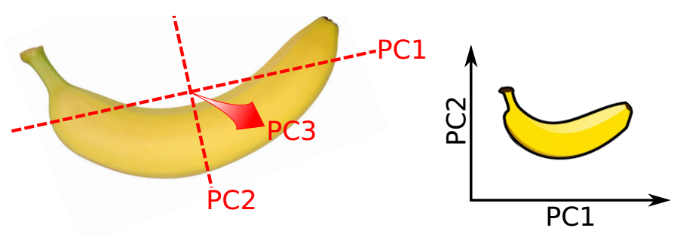
Dimensionality reduction with PCA
Identifies axes of maximal variance in high-dimensional data
Each subsequent principal component explains less variance
Use the first few PCs as a “summary” of the relevant variance in the data
Speed up downstream analyses by reducing dimensionality
Focus on biology, remove random noise in later PCs
https://www.youtube.com/watch?v=FgakZw6K1QQ
Slide adapted from Single-cell Analysis Workshop by Aaron Lun, CRUK Cambridge Institute

Slide 43
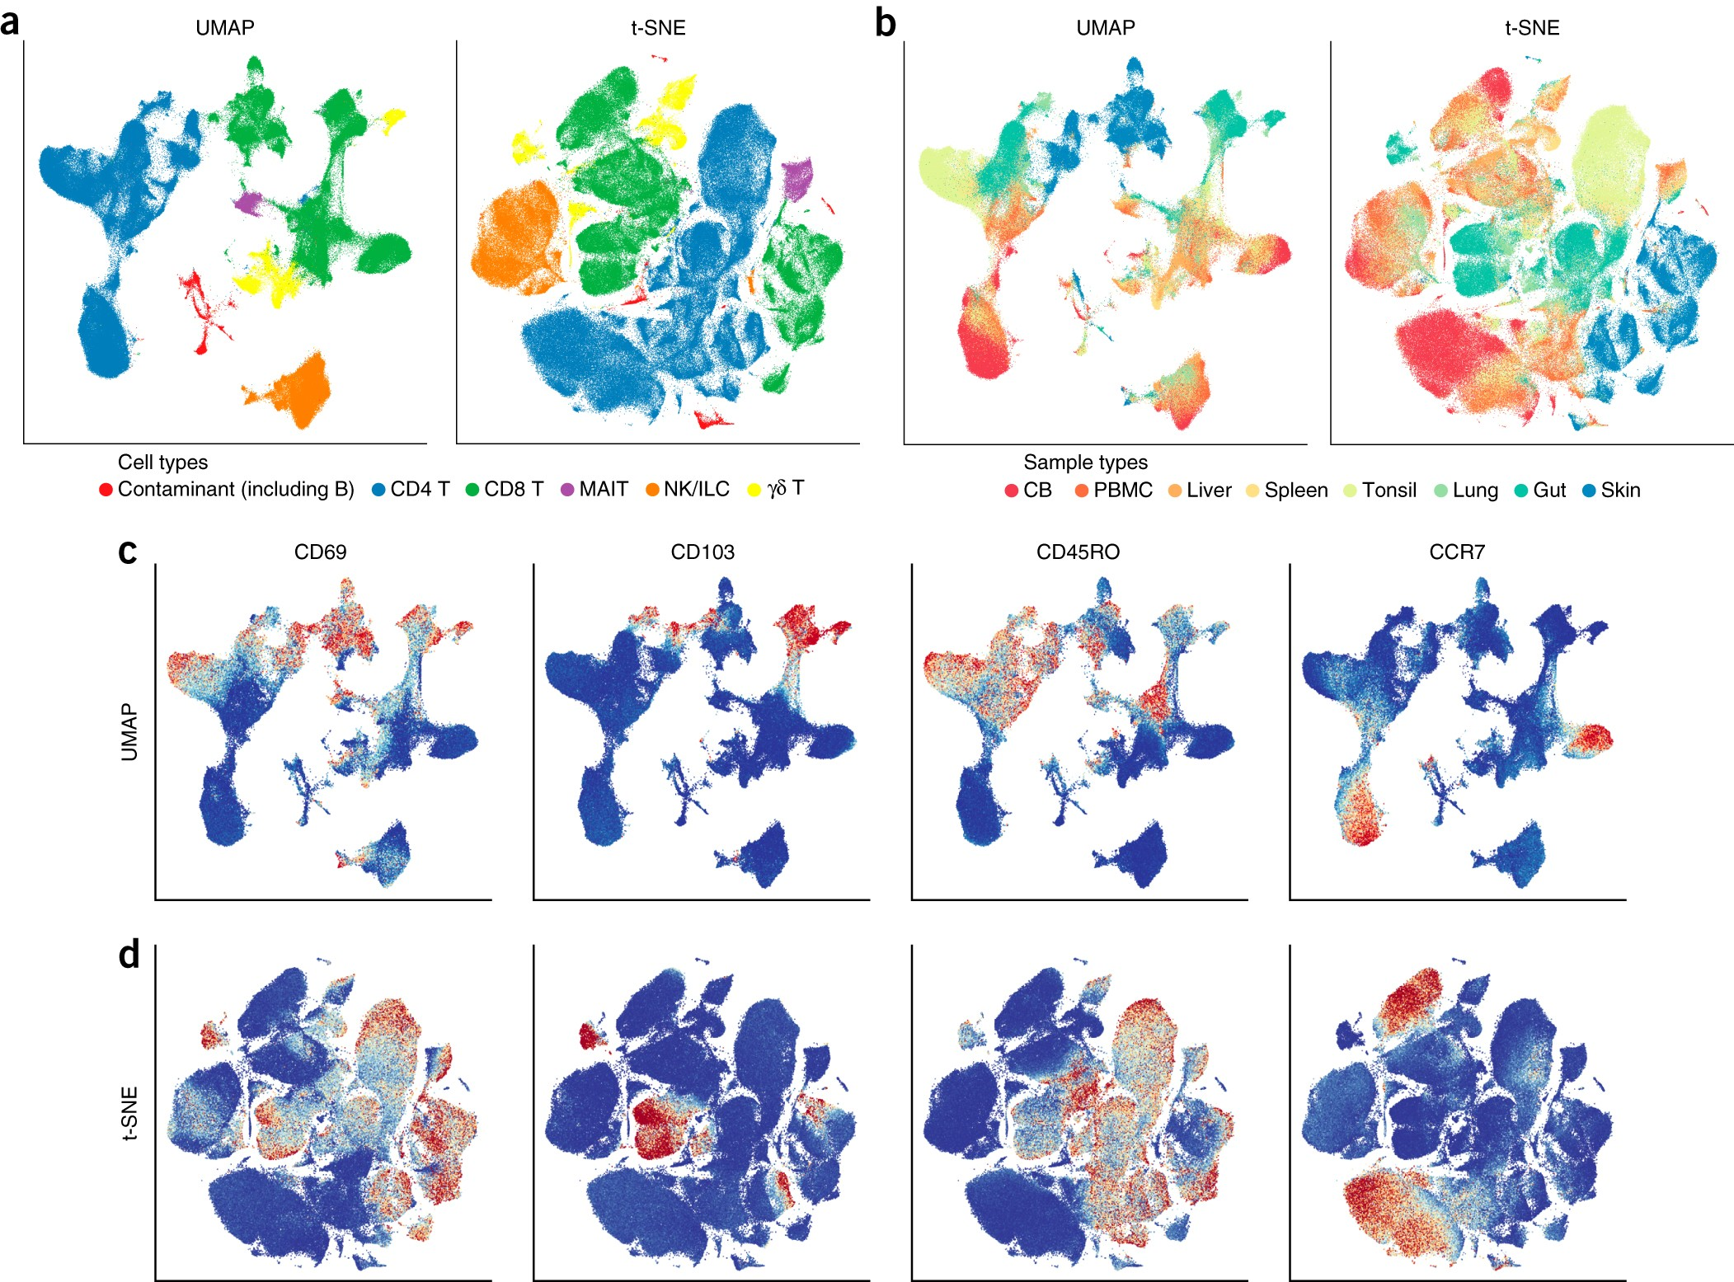
4. Clustering and visualization
Humans have a hard time understanding non-2D data
Humans find non-2D data hard because our senses and brains evolved for 3D physical survival, not abstract n-D spaces.
We rely on dimensionality reduction, metaphor, and math to bridge that gap- but those come with distortions.

Slide 44
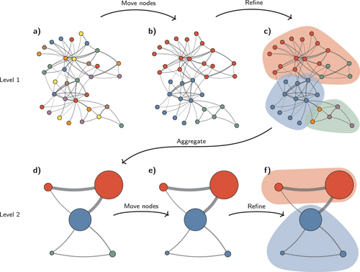
4. Clustering
Unsupervised algorithms (e.g., Louvain or Leiden) that group bins based on similarities across the full gene expression space.
Which regions within the tissue share similar transcriptional signatures, which may correspond to distinct anatomical structures or functional states.

Slide 45
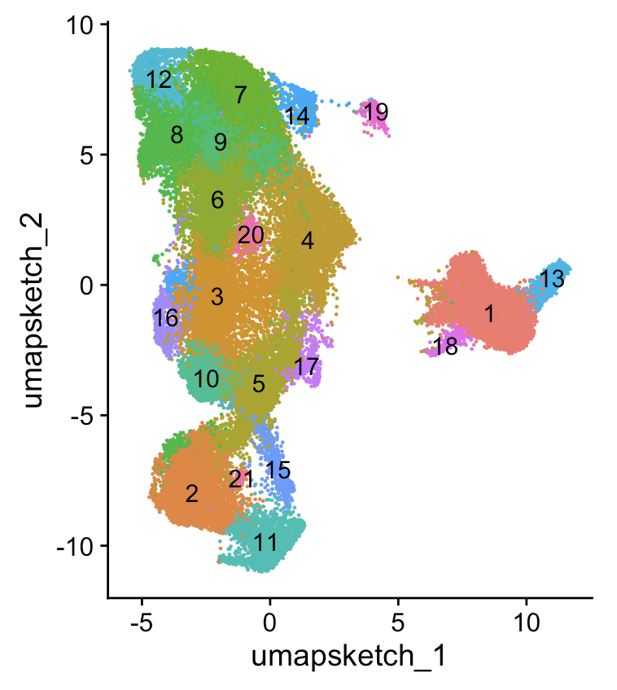
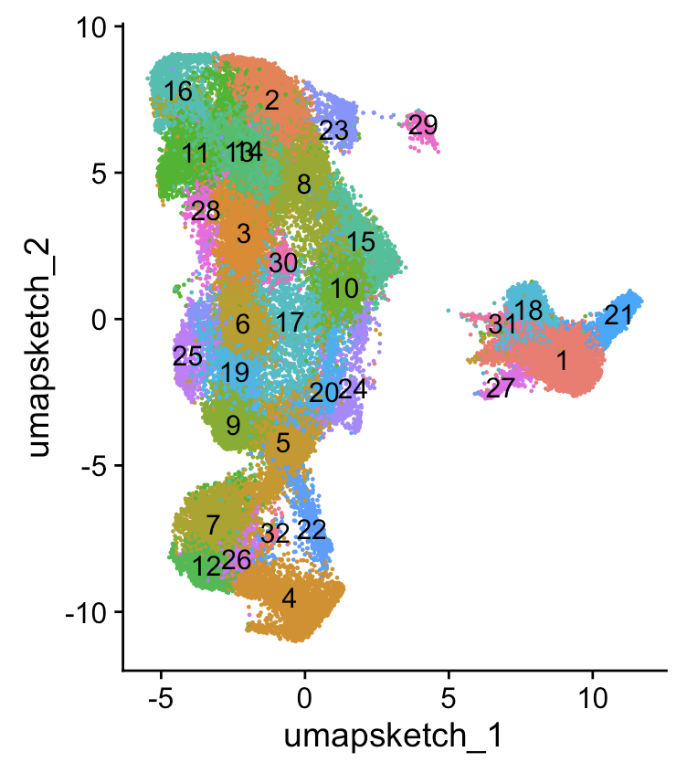
4. Clustering resolution
Cluster resolution is a parameter that controls the granularity of clustering in Seurat.
Higher resolution > more clusters
Lower resolution > fewer clusters
Res=0.8
Res=2
Keep in mind that the optimal cluster resolution may vary between datasets and experiments.
Right balance between granularity and interpretability of the results.

Slide 46
4. UMAP (Uniform Manifold Approximation and Projection)
UMAP is a dimensionality reduction technique that projects high-dimensional data into a lower-dimensional space.
Each bin is shown as a point, allowing us to detect substructures or transitions within clusters

Slide 47
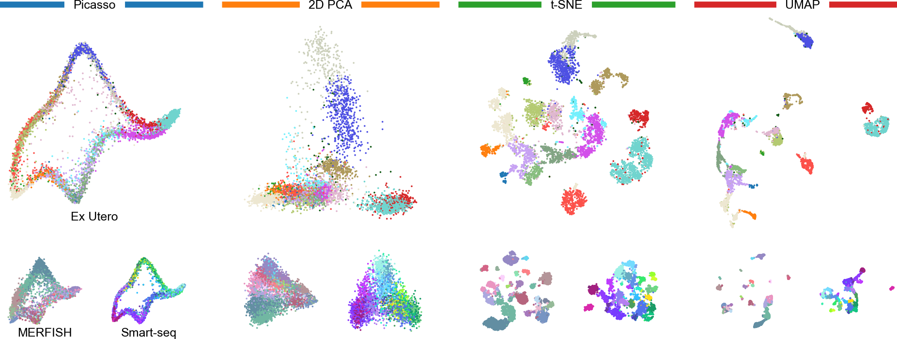
Visualization with distortion
Lause J, Berens P, Kobak D (2024) The art of seeing the elephant in the room: 2D embeddings of single-cell data do make sense. PLOS Computational Biology 20(10): e1012403. https://doi.org/10.1371/journal.pcbi.1012403

Slide 48
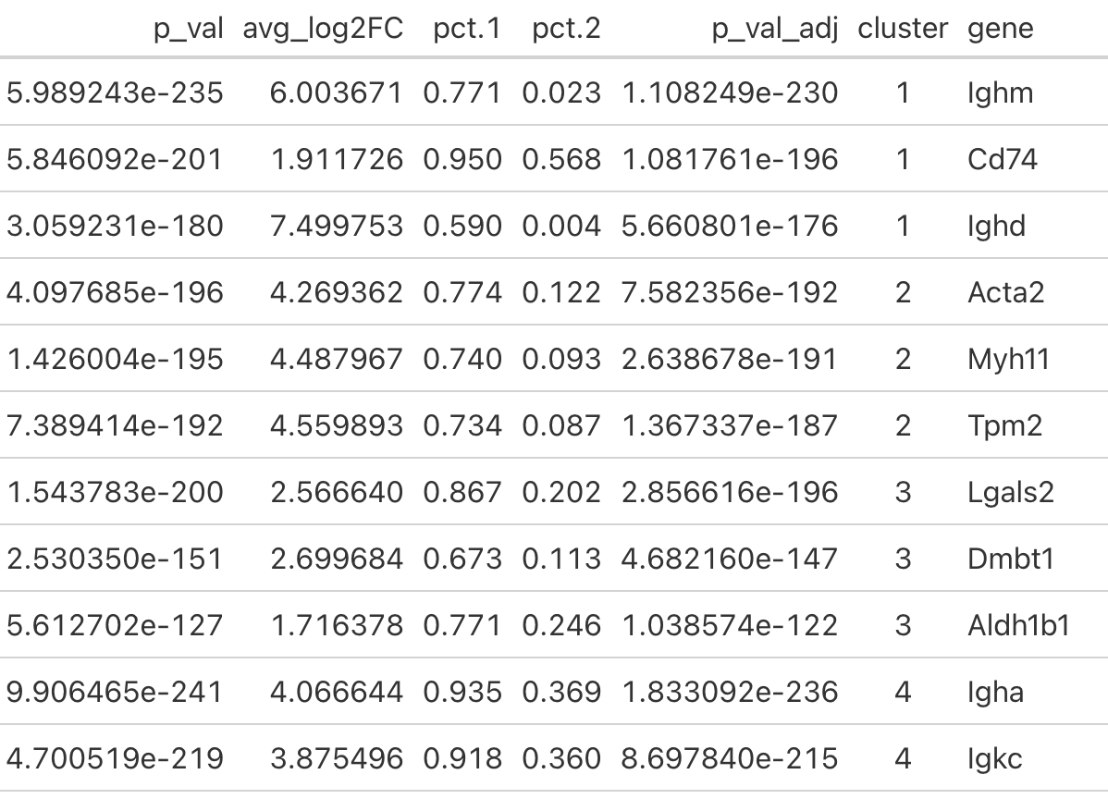
5. Cluster annotation
What cell-type corresponds to each
cluster?
Calculate signature markers
- (Package-based cell annotation)
Literature or in-house markers for cell annotation
Reference mapping (single cell deconvolution)

Slide 49
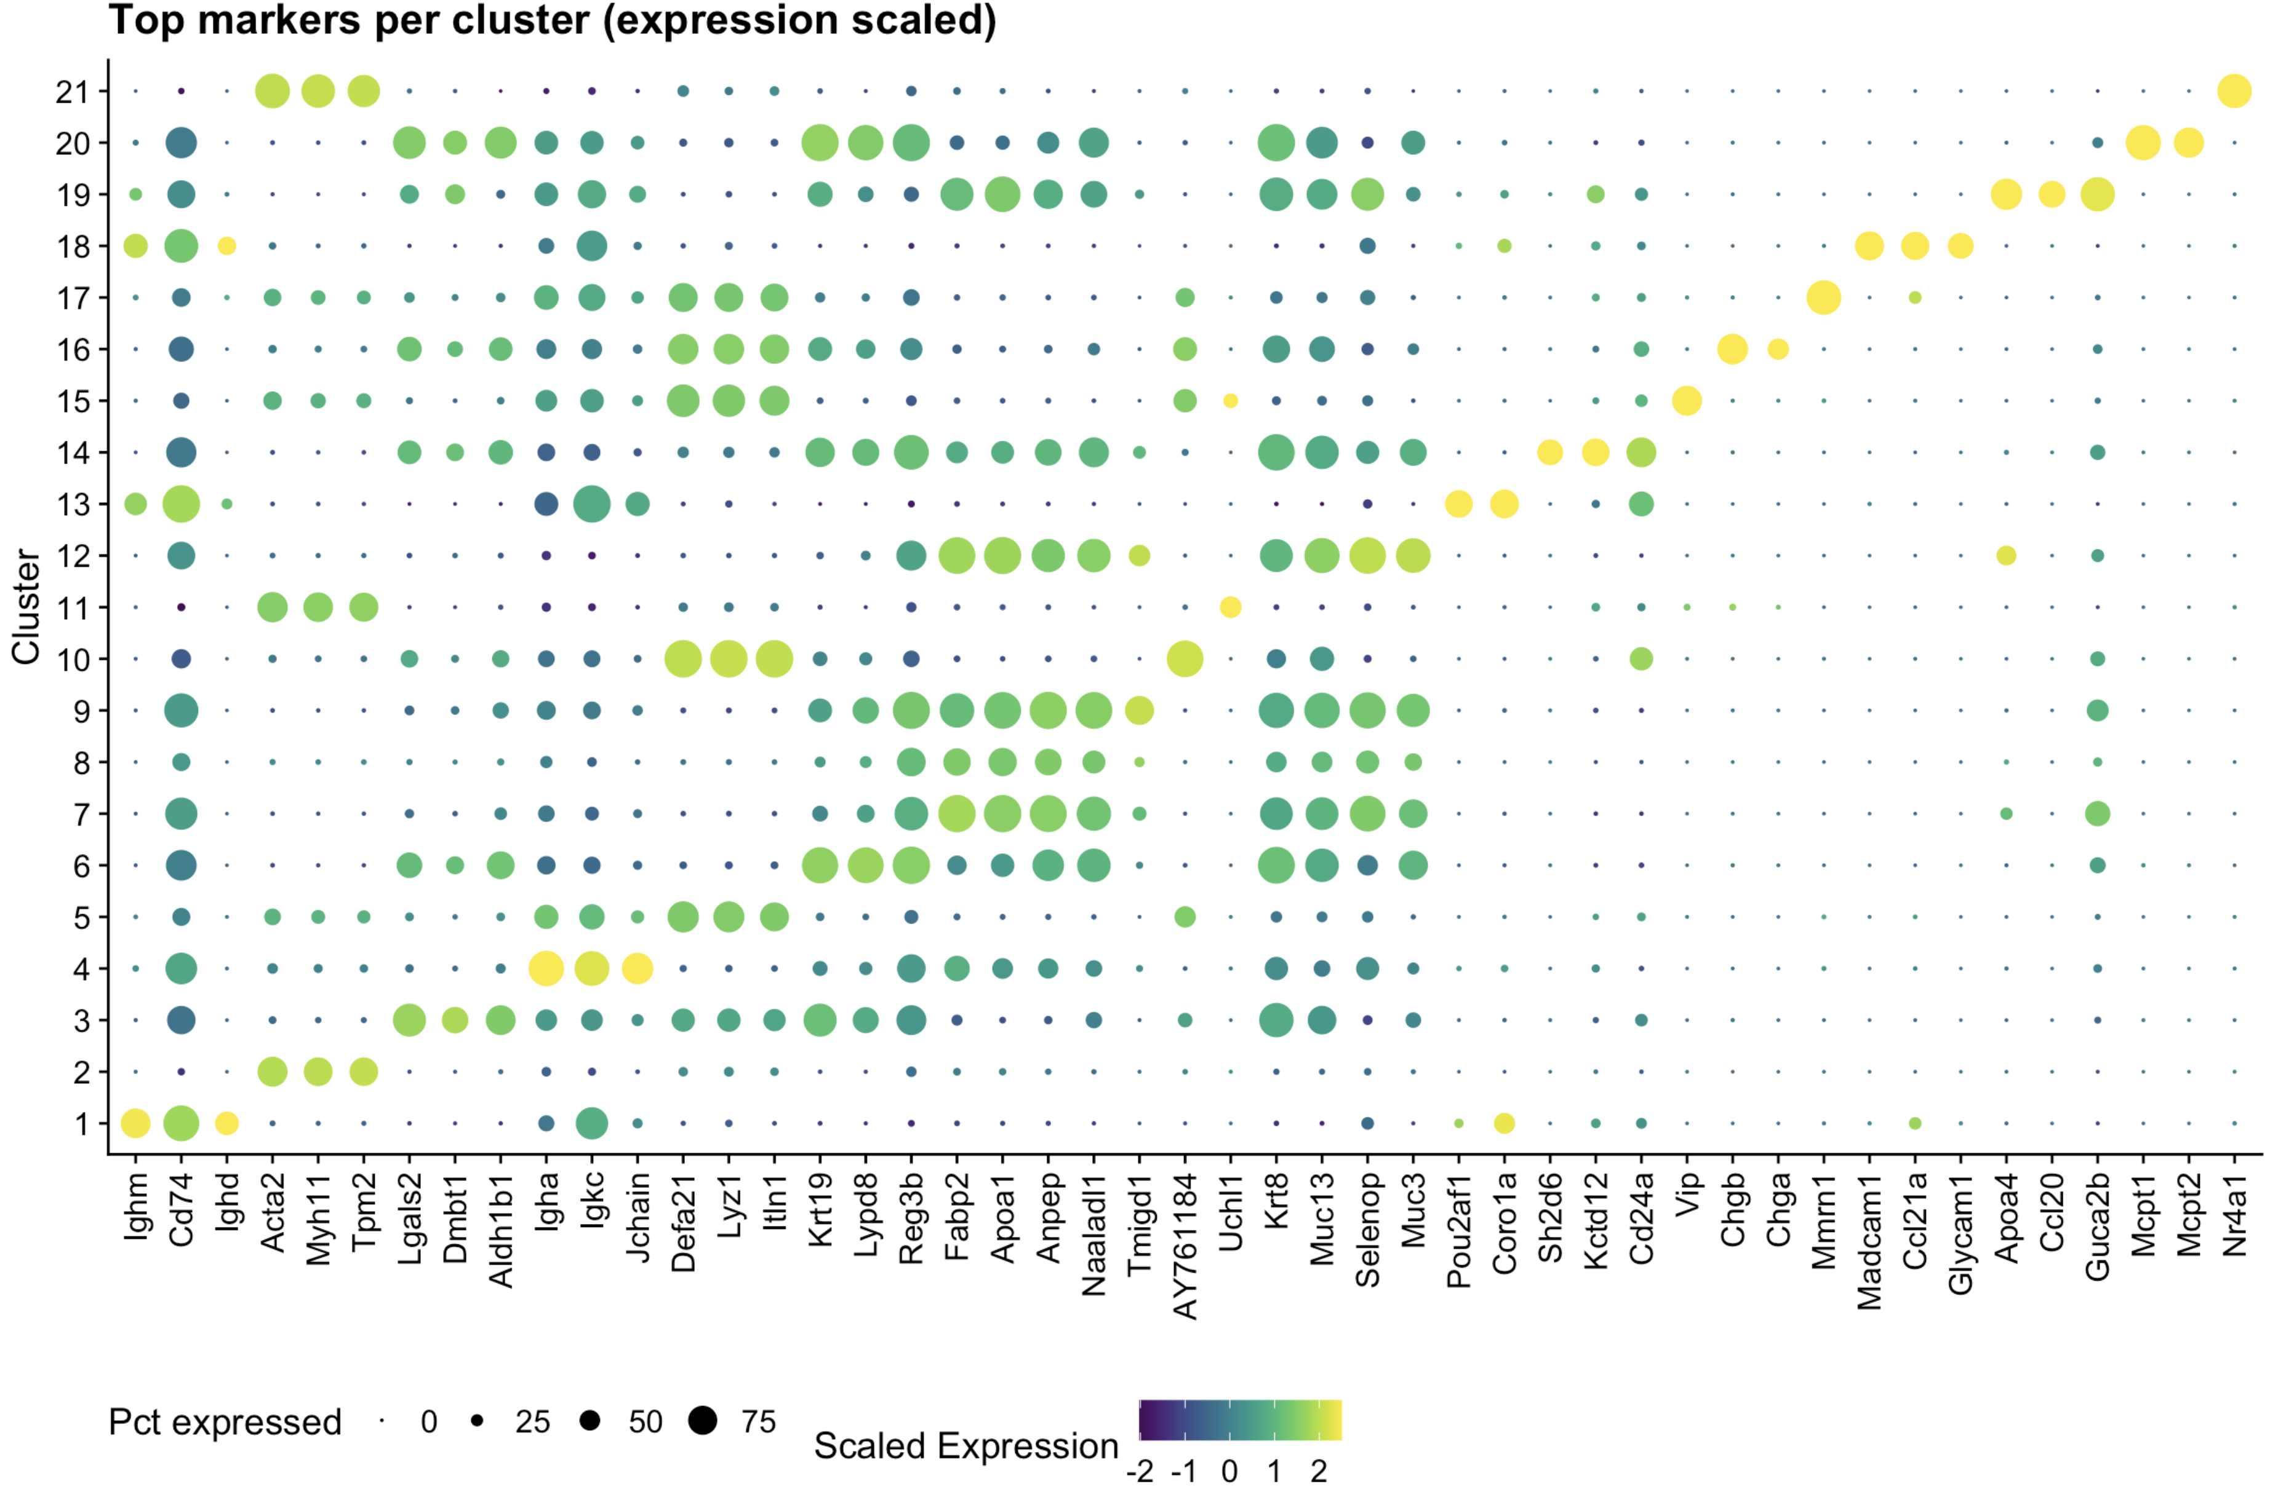
5. Cluster annotation
Signature markers per cluster

Slide 50
5. Reference cell annotation
Reference based method
Choose a reference available in literature or in-house.
Use the annotated cells to do cell deconvolution of your spatial dataset
Advantages:
Disadvantages:

Slide 51
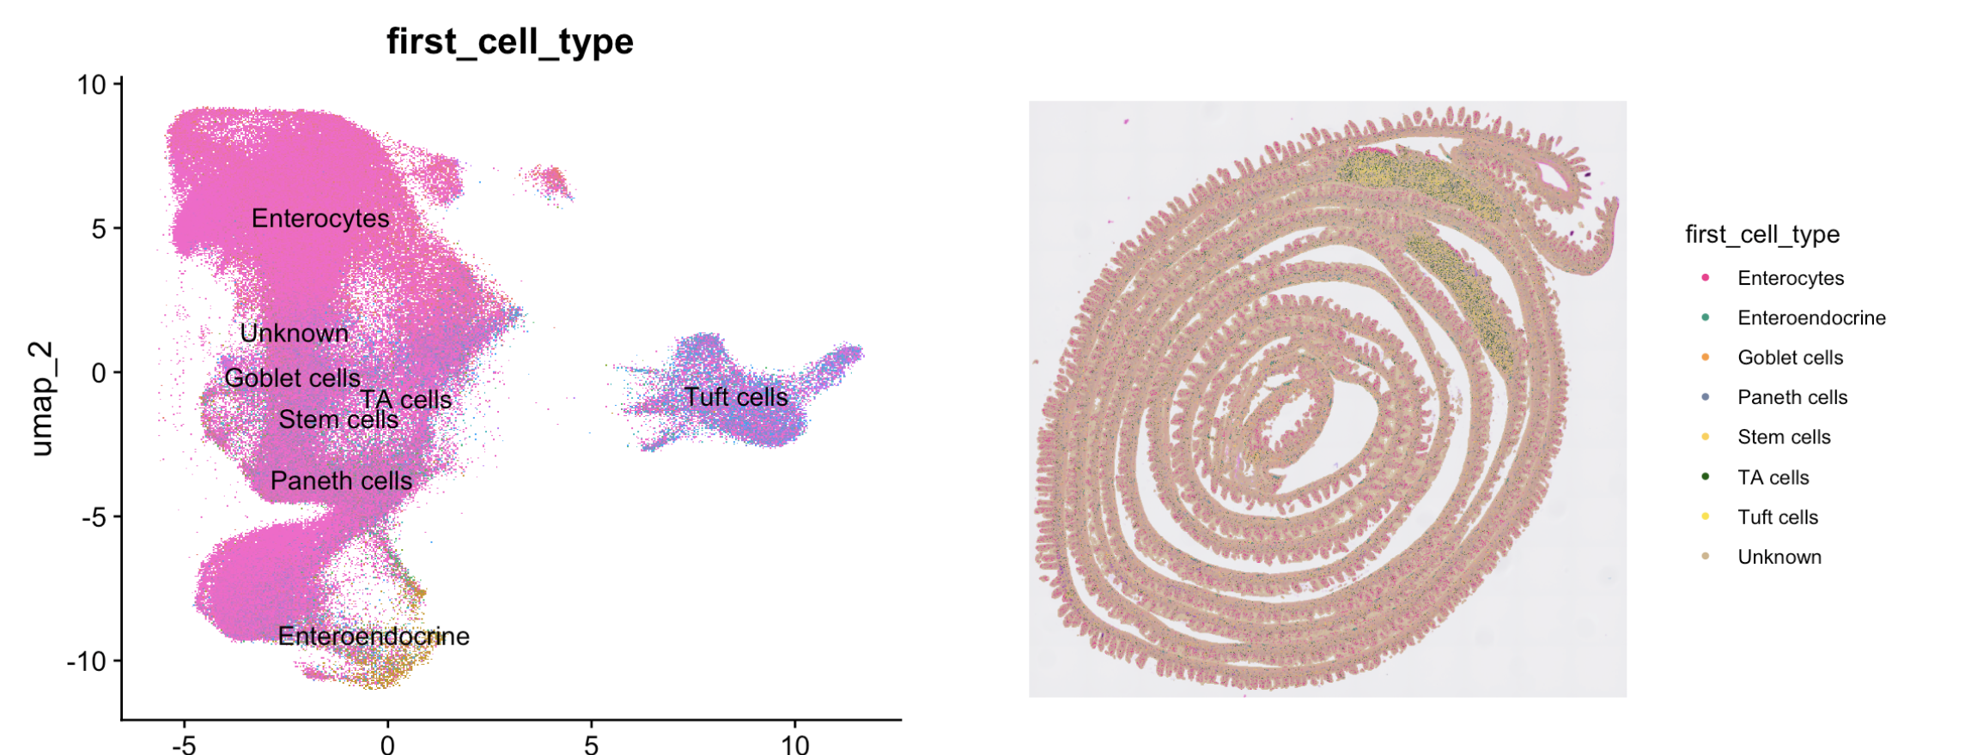
Reference based annotation
Notes:
We would like to better understand the molecular signatures of remission of IBD symptoms.
We have been defining clinical remission based on disease activity scores. Disease activity scores are establish by compounding of different aspects of the disease; using stool frequency and rectal bleeding, together with endoscopy and an overall evaluation by a physician.
Unfortunately these scores are prone to biases- for example, environmental factors can impact stool frequency (also a physician that is exposed to many atopic tissues a mild inflammation could be misevaluated)
Different biomarkers have been used in clinical trials, however there were some accuracy restrictions
Therefor, We believe there is a need for an independent molecular signature, that is based on expression of a small set of biomarkers. Ideally, such molecular signature would be independent of external factors, such as, drug-specific mechanisms of actions and would be representative of mucosal healing.

Slide 52
5. Literature or in-house markers
Scientists have been using cell expression to identify cells for decades.
Use (e.g. flow cytometry) markers to identify your cells based on cluster expression.
Advantages:
Disadvantages:

Slide 53
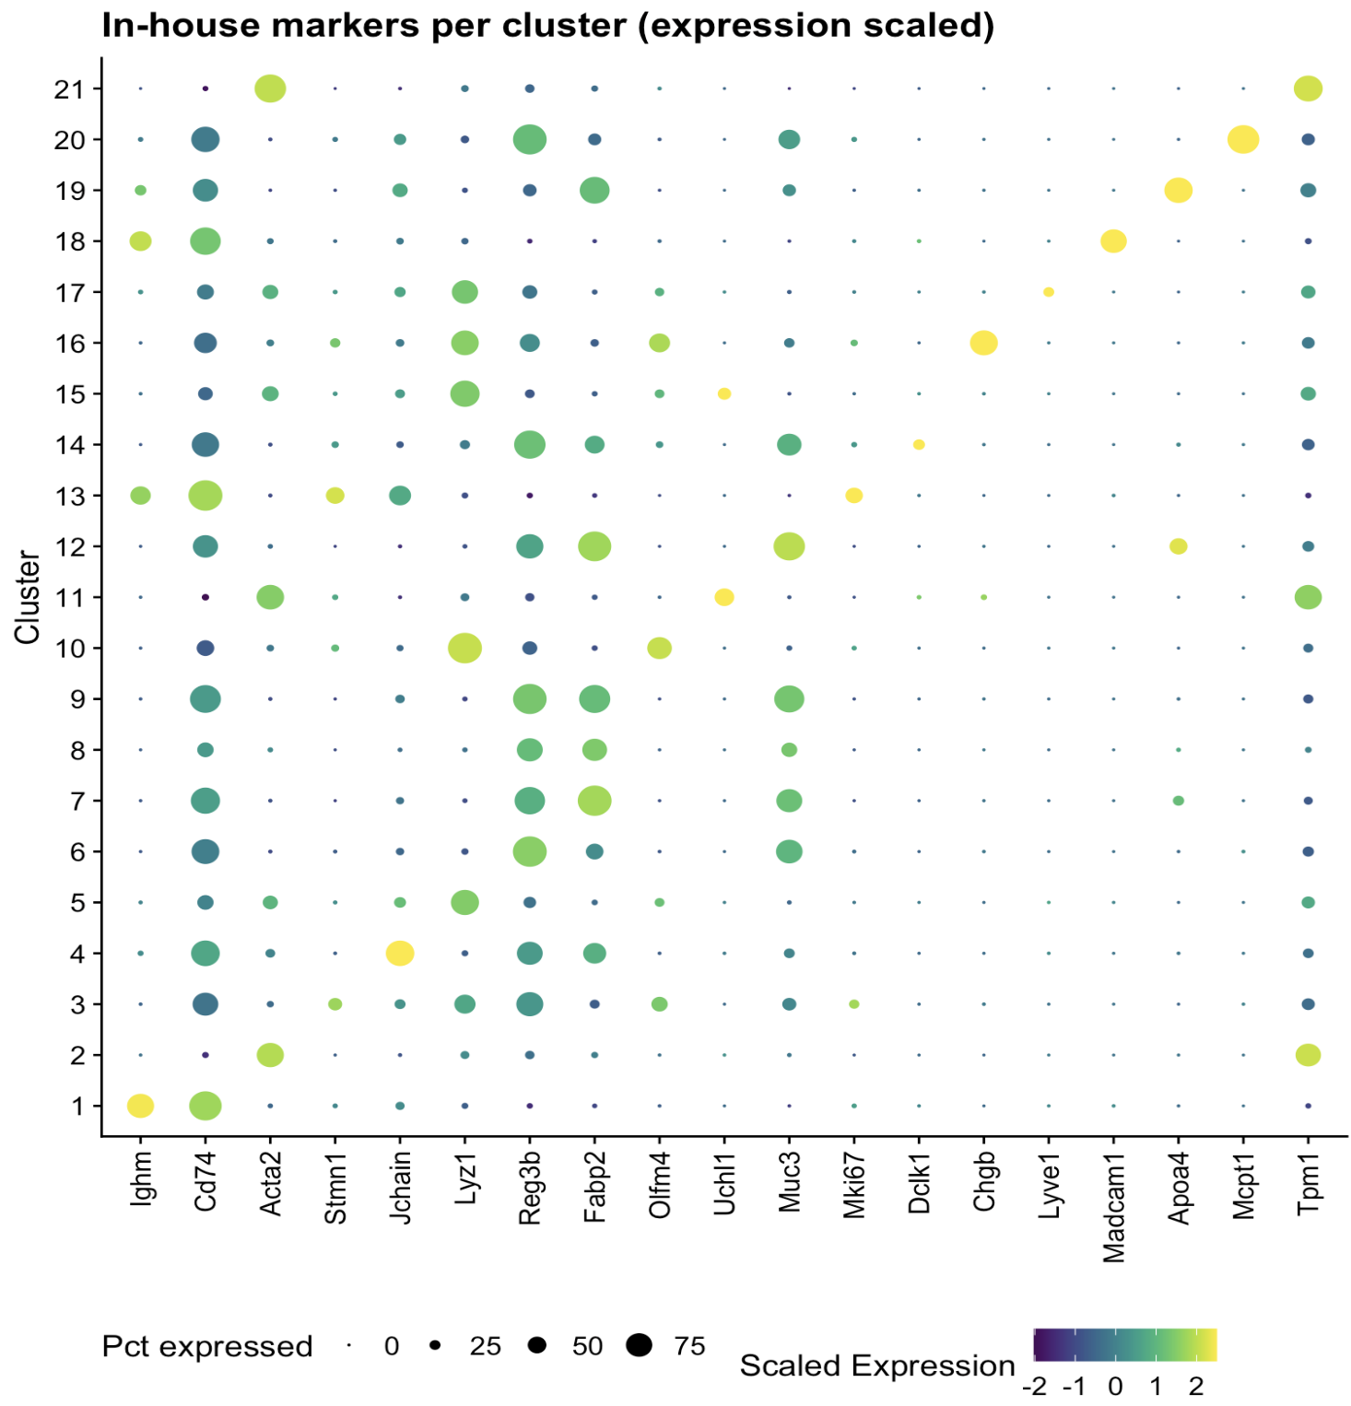
Cluster based annotation (in-house/literature knowledge)
1: Immune cells
2: Stromal
...
20: Mast cells
21: Stromal
Notes:
We would like to better understand the molecular signatures of remission of IBD symptoms.
We have been defining clinical remission based on disease activity scores. Disease activity scores are establish by compounding of different aspects of the disease; using stool frequency and rectal bleeding, together with endoscopy and an overall evaluation by a physician.
Unfortunately these scores are prone to biases- for example, environmental factors can impact stool frequency (also a physician that is exposed to many atopic tissues a mild inflammation could be misevaluated)
Different biomarkers have been used in clinical trials, however there were some accuracy restrictions
Therefor, We believe there is a need for an independent molecular signature, that is based on expression of a small set of biomarkers. Ideally, such molecular signature would be independent of external factors, such as, drug-specific mechanisms of actions and would be representative of mucosal healing.

Slide 54
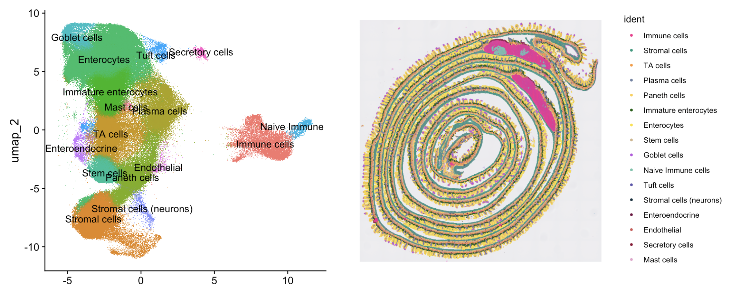
In-house based annotation
Notes:
We would like to better understand the molecular signatures of remission of IBD symptoms.
We have been defining clinical remission based on disease activity scores. Disease activity scores are establish by compounding of different aspects of the disease; using stool frequency and rectal bleeding, together with endoscopy and an overall evaluation by a physician.
Unfortunately these scores are prone to biases- for example, environmental factors can impact stool frequency (also a physician that is exposed to many atopic tissues a mild inflammation could be misevaluated)
Different biomarkers have been used in clinical trials, however there were some accuracy restrictions
Therefor, We believe there is a need for an independent molecular signature, that is based on expression of a small set of biomarkers. Ideally, such molecular signature would be independent of external factors, such as, drug-specific mechanisms of actions and would be representative of mucosal healing.

Slide 55
What we learned
Preparation of samples into the spatial object.
How to annotate the single cell object.

Slide 56
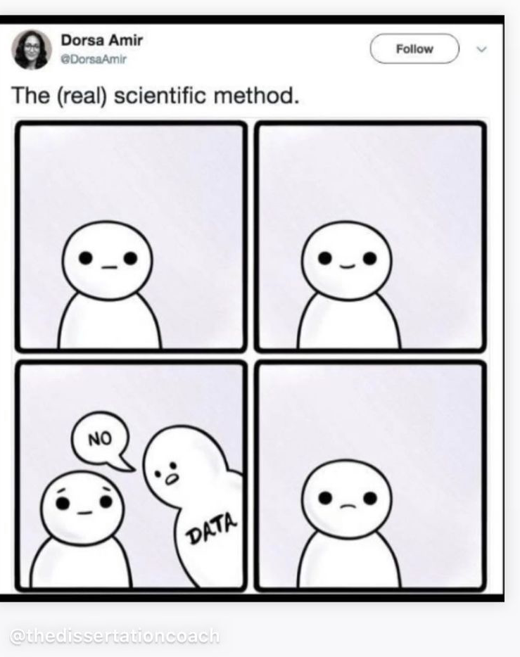
Questions?

Slide 57






Where can I get public data?
Best practices:
- [Single-cell best practices](https://www.sc-best-practices.org/preamble.html)
- [Orchestrating Single-Cell Analysis with Bioconductor
](https://bioconductor.org/books/release/OSCA/)
- [Orchestrating Spatial Transcriptomics Analysis with Bioconductor
](https://lmweber.org/OSTA/)
- Seurat:
- [Essential commands](https://satijalab.org/seurat/articles/essential_commands)
- [Basic Single-cell Analysis Vignette](https://satijalab.org/seurat/articles/pbmc3k_tutorial)
- [Seurat Visium Analysis Vignette](https://satijalab.org/seurat/articles/spatial_vignette)
- [Seurat Visium HD Analysis Vignette](https://satijalab.org/seurat/articles/visiumhd_analysis_vignette)
- Tools:
- [Spaceranger](https://www.10xgenomics.com/support/software/space-ranger/latest)
- [Loupe Browser](https://www.10xgenomics.com/support/software/loupe-browser/latest)
- [Spotsweeper](https://github.com/MicTott/SpotSweeper)
- [banksy](https://github.com/prabhakarlab/Banksy)….

